Slide 1

Database Systems
LECTURE 5 and 6

Slide 2
Review of Last Lecture:

Slide 3
Why is Data Modeling important (And what are the benefits)?
Higher Quality Applications
Reduced Cost & Time of Application Development
Early Detection of Data Issues & Errors
Faster Application Performance
Better Documentation for long term maintenance

Slide 4
Types of Data Models :
1. Hierarchical Data Model
A hierarchical data model is a structure for organizing data into a tree-like hierarchy, otherwise known as a parent-child relationship.
A typical example is a sales order: it has many sales items, but each sales item can be associated with only one sales order. The sales order is the parent entity, and the sales item is the child entity.
Hierarchical Data Model can be effective for certain types of applications with a clear parent-child relationship, its limitations in flexibility, complexity, and query capabilities make it less suitable for modern database needs, particularly in environments that require more dynamic and complex data interactions.

Slide 5
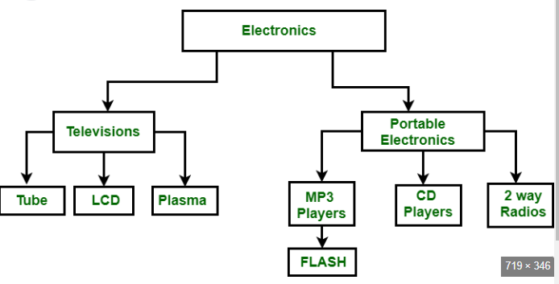

Slide 6
Types of Data Models :
2. Relational Data Model
A relational model contains nodes that are related to each other through links that contain relational data. These models are commonly used to create databases for storing and retrieving information quickly and easily.
The idea behind relational databases is to store all types of data in one table, as long as each column represents a unique piece of information about the entity.

Slide 7
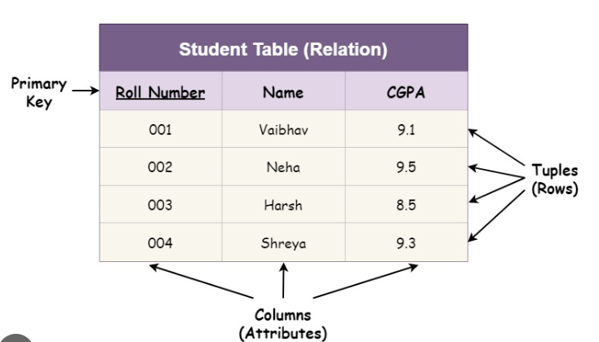
A simple example would be a table for storing information about people. The table would have columns for the first name, last name, social security number, birth date, etc.

Slide 8
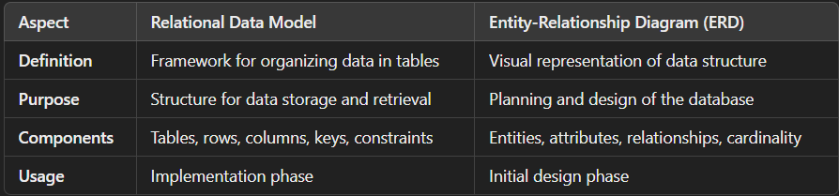
Difference between relational data model and ERD:

Slide 9
Types of data models:
3. The Entity-relationship (ER)
The Entity-relationship (ER) model is a method of representing your data in an organized way.
The ER diagram provides a visual representation of how your data is related and what processes need to be supported by the database. Also, it shows how these different types of data are related to each other.

Slide 10
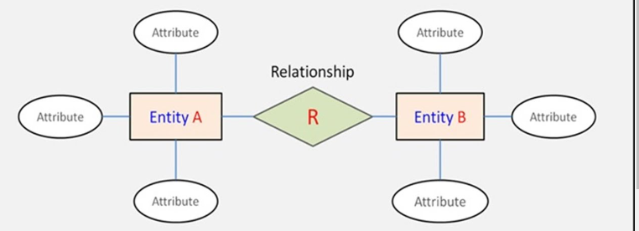

Slide 11
Types of data models:
4. Object-oriented Data Model
An object-oriented data model is a conceptual data model that uses objects to describe and define information.
Objects are real-world items that are made up of several attributes. For example, customers have names, addresses, phone numbers, email addresses, etc.

Slide 12
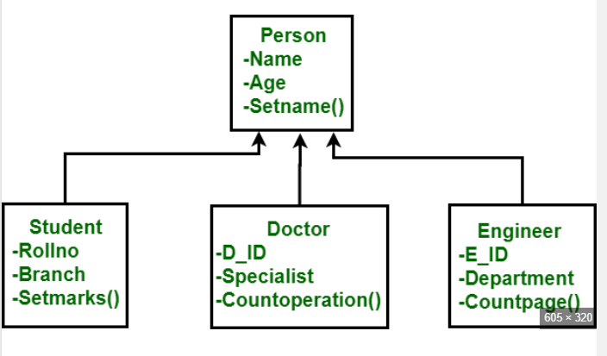

Slide 13
Types of data models:
5. Dimensional Data Model
Dimensional data models are the foundation of business intelligence (BI) and online analytical processing (OLAP) systems.
These models are typically implemented for data warehouses containing historical transactional data but can also be applied to smaller data sets.
Dimensional data models often reference multiple structures that include fact tables, dimension tables, and lookup tables
The main purpose of a dimensional model is to help users find answers to their questions about business forecasts, consumption trends, and other related questions quickly.
Dimensional modeling provides an organized method for business intelligence reporting. It allows users to share information across different departments within an organization for effective collaboration and decision-making.

Slide 14
Entity Relationship Models

Slide 15
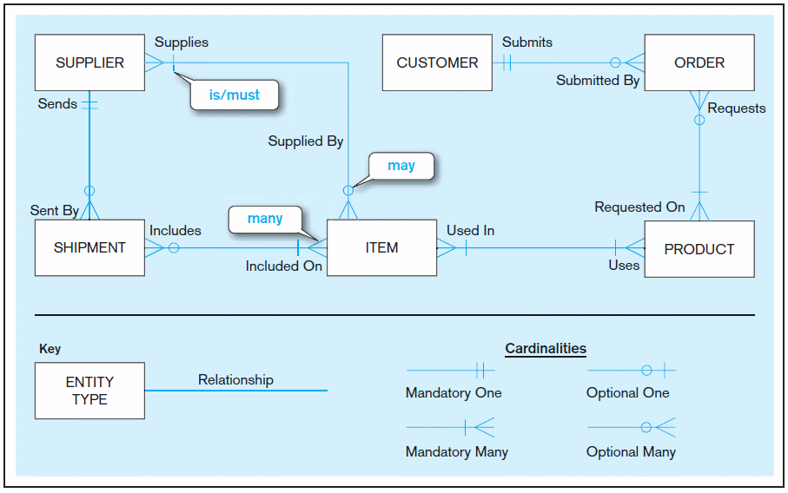
Sample E-R Diagram

Slide 16

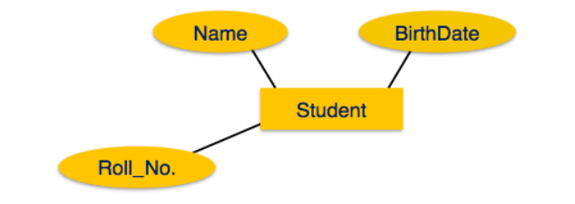
DBMS - ER Diagram Representation
Entity
Entities are represented by means of rectangles. Rectangles are named with the entity set they represent.
Attributes
Attributes are the properties of entities. Attributes are represented by means of ellipses. Every ellipse represents one attribute and is directly connected to its entity (rectangle).

Slide 17
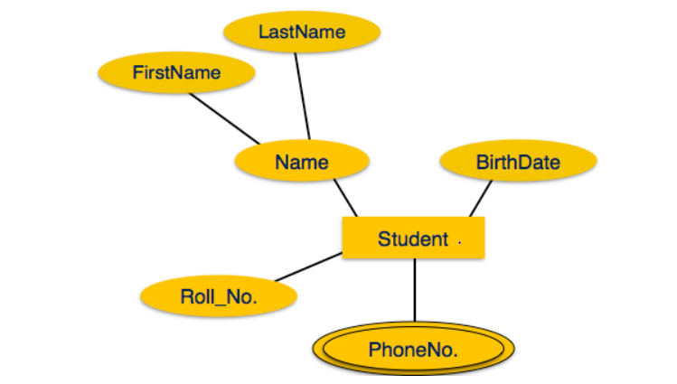
DBMS - ER Diagram Representation
Multivalued attributes are depicted by double ellipse.

Slide 18
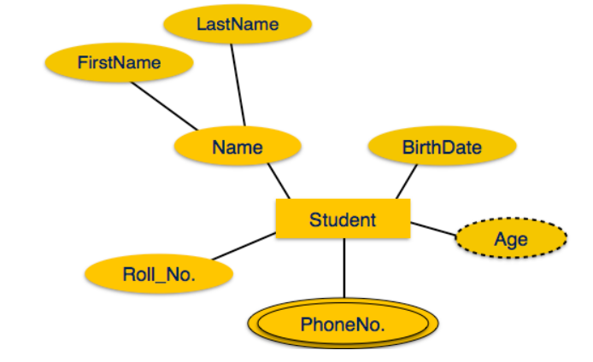
DBMS - ER Diagram Representation
Derived attributes are depicted by dashed ellipse.

Slide 19
Relationship
Relationships are represented by diamond-shaped box. Name of the relationship is written inside the diamond-box. All the entities (rectangles) participating in a relationship, are connected to it by a line.
Binary Relationship and Cardinality
A relationship where two entities are participating is called a binary relationship. Cardinality is the number of instance of an entity from a relation that can be associated with the relation.

Slide 20
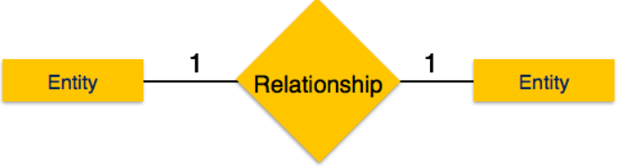
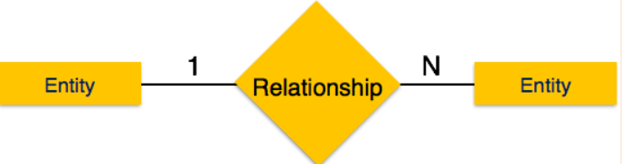
Relationship
One-to-one − When only one instance of an entity is associated with the relationship, it is marked as '1:1’.
One-to-many − When more than one instance of an entity is associated with a relationship, it is marked as '1:N’.

Slide 21
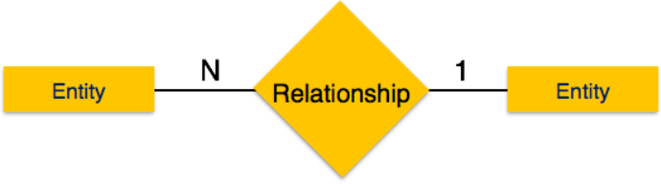
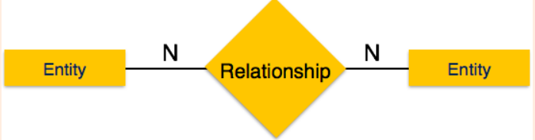
Relationship
Many-to-one − When more than one instance of entity is associated with the relationship, it is marked as 'N:1’.
Many-to-many

Slide 22
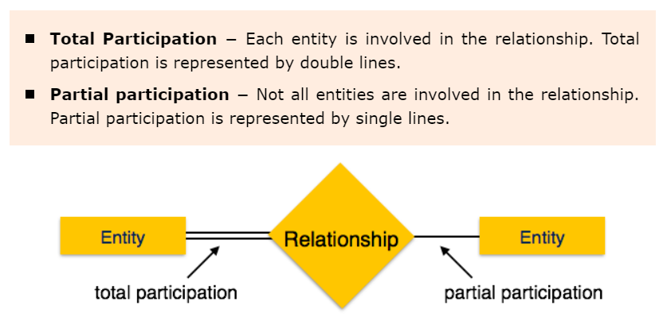
Participation constraints:

Slide 23
Total Participation:
Total Participation
Definition: Every instance of an entity is involved in the relationship. In other words, for every entity in that set, there must be at least one related instance in the associated entity set.
Representation: This is depicted using double lines connecting the entity to the relationship in the ERD.
Example: Consider a university database with a relationship called "Enrolls" between "Students" and "Courses." If every student must enroll in at least one course, this indicates total participation for the "Students" entity.

Slide 24
Partial Participation
Partial Participation
Definition: Not all instances of an entity are involved in the relationship. Some instances may exist without a corresponding instance in the related entity set.
Representation: This is represented by single lines connecting the entity to the relationship in the ERD.
Example: In the same university database, if a "Course" can exist without any students enrolled (for example, if it’s a new course that hasn’t started yet), this indicates partial participation for the "Courses" entity.

Slide 25
Partial Participation Example:
Students and Extracurricular Activities
Entities: Students and Extracurricular Activities
Relationship: Participates In
Partial Participation: Not all students participate in extracurricular activities. Some may choose to focus solely on academics, meaning "Students" have partial participation in the "Participates In" relationship.

Slide 26
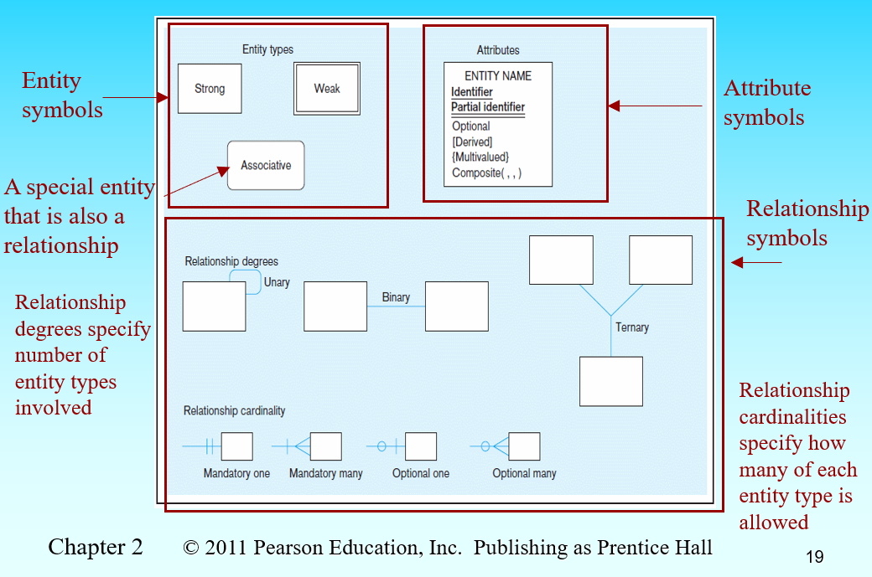
Basic E-R notation

Slide 27
Degree of Relationships.
Degree of a relationship is the number of entity types that participate in it
Unary Relationship
Binary Relationship
Ternary Relationship

Slide 28
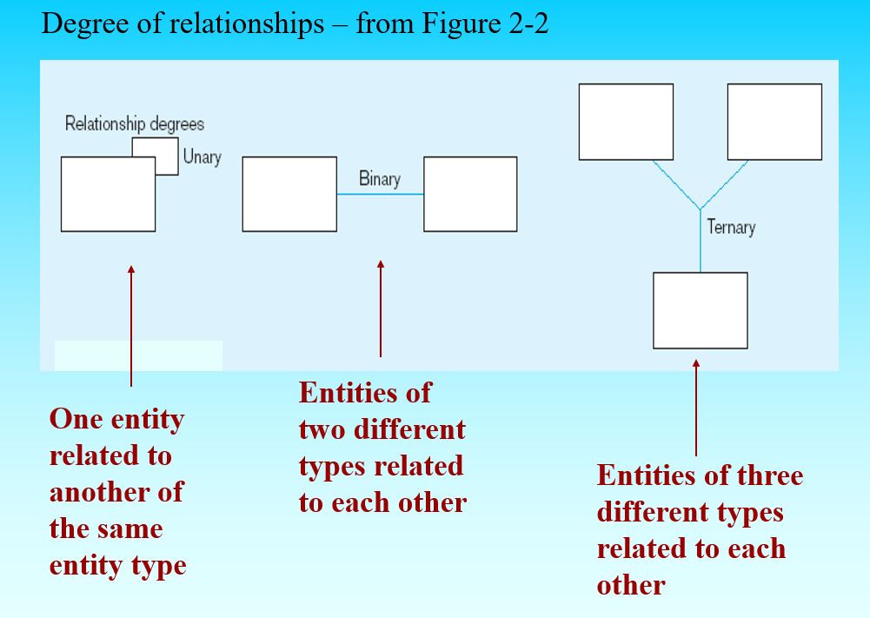
Degree of Relationships.

Slide 29
Cardinality Constraints
Cardinality Constraints—the number of instances of one entity that can or must be associated with each instance of another entity
Minimum Cardinality
If zero, then optional
If one or more, then mandatory
Maximum Cardinality
The maximum number

Slide 30
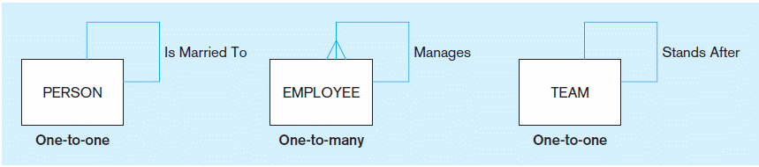
Example of unary relationship:

Slide 31
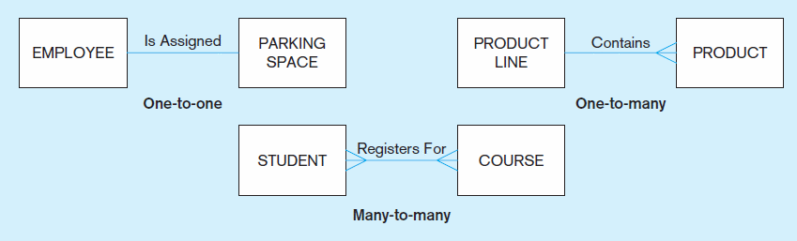
Example of binary relationship:

Slide 32
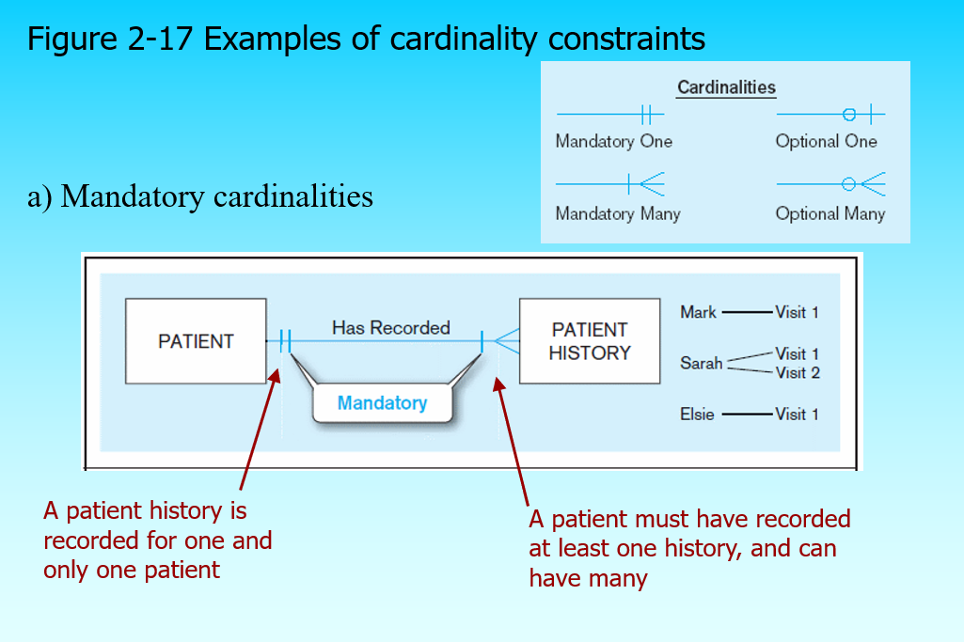

Slide 33
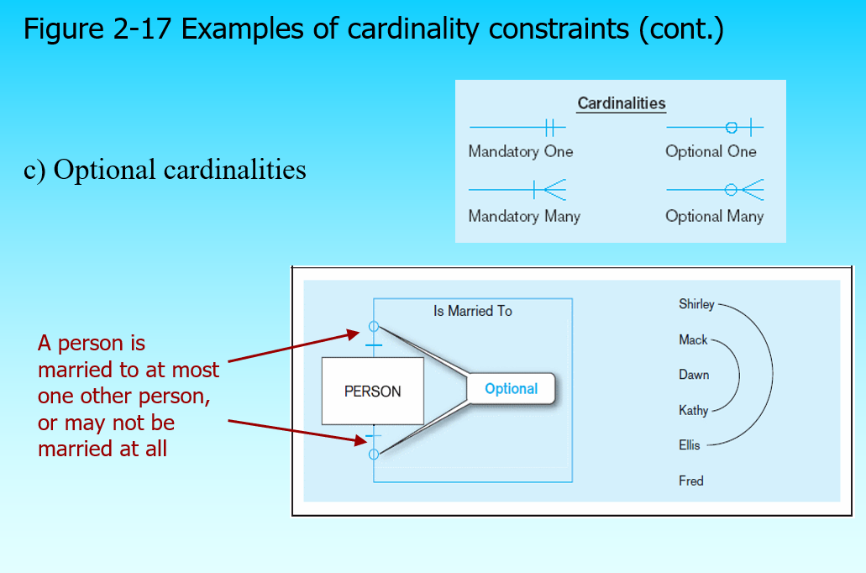

Slide 34
Strong vs. Weak Entities
Strong entity
exists independently of other types of entities
A strong entity will always have a primary key.
Strong entities are represented by a single rectangle.
The relationship of two strong entities is represented by a single diamond.
Various strong entities, when combined together, create a strong entity set.
Weak entity
dependent on a strong entity (identifying owner)…cannot exist on its own
entity box has double line

Slide 35
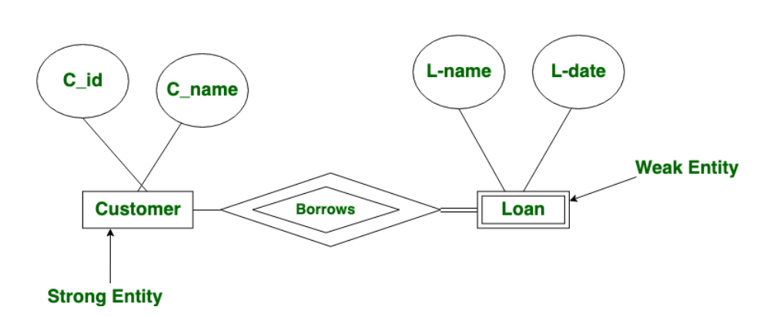

Slide 36
Today’s Lecture

Slide 37
DBMS - Data Independence
If a database system is not multi-layered, then it becomes difficult to make any changes in the database system. Database systems are designed in multi-layers.
A database system normally contains a lot of data in addition to users’ data. For example, it stores data about data, known as metadata, to locate and retrieve data easily. It is rather difficult to modify or update a set of metadata once it is stored in the database. But as a DBMS expands, it needs to change over time to satisfy the requirements of the users. If the entire data is dependent, it would become a tedious and highly complex job.
Metadata itself follows a layered architecture, so that when we change data at one layer, it does not affect the data at another level. This data is independent but mapped to each other.

Slide 38
Schema

Slide 39
Data Schemas
A database schema is the skeleton structure that represents the logical view of the entire database. It defines how the data is organized and how the relations among them are associated. It formulates all the constraints that are to be applied on the data.
A database schema defines its entities and the relationship among them. It contains a descriptive detail of the database, which can be depicted by means of schema diagrams. It’s the database designers who design the schema to help programmers understand the database and make it useful.
We use DDL to design a schema. (We will study DDL in detail in upcoming lectures.
A schema can have more than one table.

Slide 40
Three Schema Architecture:
Schema means structure. We have.
1. External schema
2. Logical Schema
3. Physical Schema

Slide 41
External Schema (View Level)
What it is: This is how users interact with the data. It includes different views of the database tailored to specific user needs.
Example: Imagine a library system. A librarian might need to see all book details, while a customer might only want to see book titles and availability. Each of these is a different external schema.
Purpose: To provide a user-friendly way of accessing data without overwhelming users with all the details.

Slide 42
Conceptual Schema (Logical Level)
What it is: This level describes what data is stored in the database and the relationships between the data. It’s the overall structure of the entire database.
Example: In the library example, the conceptual schema would define the tables for books, authors, and customers, along with how they relate (e.g., which authors wrote which books).
Purpose: To provide a unified view of the entire database, ensuring that all data is organized logically.

Slide 43
Internal Schema (Physical Level)
What it is: This level deals with how data is physically stored in the database. It includes details about the storage devices, file structures, and access methods.
Example: Continuing with the library, the internal schema would specify how the book data is actually stored on a hard drive, such as in binary format or using specific indexing methods to make retrieval faster.
Purpose: To optimize performance and ensure that data is stored efficiently.

Slide 44
Why Use Three Schema Architecture?
Separation of Concerns: By separating how data is viewed, how it is structured, and how it is stored, developers and users can work independently without affecting each other.
Data Independence: Changes made at one level (like changing storage methods) do not impact the other levels. For example, you could change how data is physically stored without altering how users view or interact with the data.
Flexibility: It allows different users to access the same data in ways that make sense for them, enhancing usability.

Slide 45
Summary
In simple terms, the Three Schema Architecture is like a multi-layered cake:
External Layer: The frosting that users see and interact with. (interface designer/frontend designer works here)
Middle Layer: The sponge cake that defines the structure of the cake. (database designers works here)
Bottom Layer: The base that holds everything together and ensures stability. (database administrators works here)

Slide 46
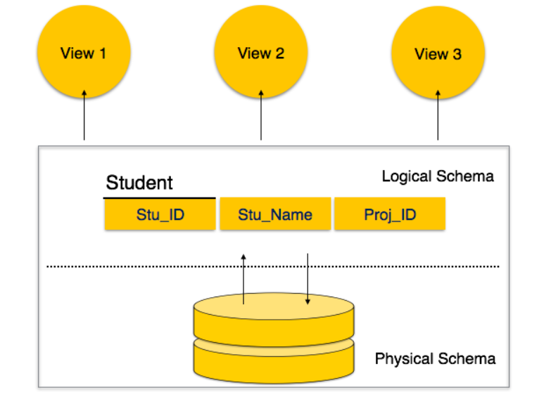

Slide 47
Database Schema
A database schema can be divided broadly into two categories −
Physical Database Schema − This schema pertains to the actual storage of data and its form of storage like files, indices, etc. It defines how the data will be stored in a secondary storage.
Logical Database Schema − This schema defines all the logical constraints that need to be applied on the data stored. It defines tables, views, and integrity constraints.

Slide 48
Database Instance
It is important that we distinguish these two terms individually. Database schema is the skeleton of database. It is designed when the database doesn't exist at all. Once the database is operational, it is very difficult to make any changes to it. A database schema does not contain any data or information.
A database instance is a state of operational database with data at any given time. It contains a snapshot of the database. Database instances tend to change with time. A DBMS ensures that its every instance (state) is in a valid state, by diligently following all the validations, constraints, and conditions that the database designers have imposed.
Print Page

Slide 49
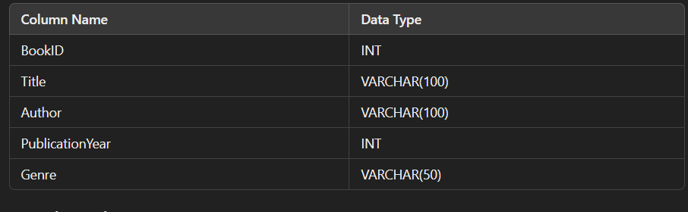
Example of a Database Instance
Let’s consider a simple database for a library, which includes a table named Books.
Schema Definition
The schema for the Books table might look like this:

Slide 50
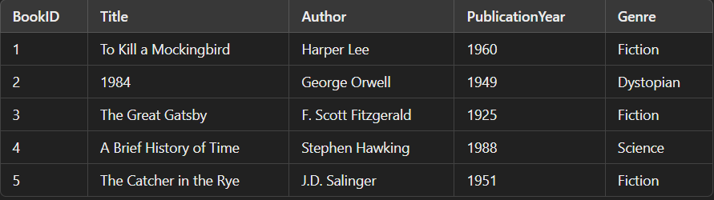
Example of database instance:

Slide 51
Key Components of a Database Schema:
Tables: The main structures where data is stored, similar to spreadsheets with rows and columns.
Fields (Columns): Each table consists of fields (or columns), which define the types of data that can be stored (e.g., names, dates, numbers).
Rows (Records): Each row in a table represents a single record or entry.
Relationships: Defines how tables are linked to one another. For example, a "Customers" table might be linked to an "Orders" table through a common field like "CustomerID."
Constraints: Rules that ensure data integrity, such as unique constraints (no duplicate values) or foreign key constraints (ensuring that a value in one table matches a value in another).

Slide 52
Example:
In a simple e-commerce database, the schema might include:
Customers Table:
CustomerID (Primary Key)
Name
Email
Phone
Orders Table:
OrderID (Primary Key)
OrderDate
CustomerID (Foreign Key linking to Customers)
TotalAmount
This structure shows how customers and orders are related, and what data is stored in each table.
In summary, a database schema is crucial for organizing data, maintaining its integrity, and ensuring efficient access and management.

Slide 53
Keys:
Key is an attribute or collection of attributes that uniquely identifies an entity among entity set.
For example, the roll_number of a student makes him/her identifiable among students.
Super Key − A set of attributes (one or more) that collectively identifies an entity in an entity set.
Candidate Key − A minimal super key is called a candidate key. An entity set may have more than one candidate key.
Primary Key − A primary key is one of the candidate keys chosen by the database designer to uniquely identify the entity set.

